Slide 1
Multi-level Modeling and Learned Resilience Modeling the flow of information to maintain/retain normal performance in the face of adversity
Michael Lanham, Geoffrey P. Morgan,
Kathleen M. Carley
gmorgan | mlanham | kathleen.carley@cs.cmu.edu

Slide 2
Overview
Overall Model Setup and Assumptions
Model Detail
Scenarios
Results
Visualization

Slide 3
Approach
Model information flow through dynamic network analysis using both
Network analytics
Agent-based Dynamic-Network modeling
Network Analytic Framework is ORA
Modeling framework is Multi-Level Construct

Slide 4
What is Multi-Level Construct?
Extension of Construct to support Meade’s idea of the “Generalized Other”.
As formulated by Meade (1922): An ego knows how it (and alters) should behave because the ego has some perception of what is typical behavior.
How we use this idea: The ego attributes X knowledge to alters it does not know because it perceives that: a) the alter is part of some group, and b) a majority of the alters I do know from that group know X.
Allows dynamic link change over time, as agents interact with agents they expect to have valuable knowledge based on their expectations.

Slide 5
The Organization
The organization has several parts of interest, these are:
Stylized C-Suite: The CEO and heads of various functional groups within that organization linked in a mesh (everyone to everyone)
The members of the C-Suite are:
CEO • HR
Ops • Security/IT
Logistics • Finance
C-Suite members communicate with peer C-Suite at other locations
Planning Team:
Comprised of Ops, Security, and Logistics
Per Location, Planning Team Size= 10% * OrgSize, [3..15]
Planning team members are distributed across locations and remain in contact with each other
Staff: all members of the organization
Notes:
Unified operation requires that these lines operate throughout planning process – and not just as a way to report plans
Future interoperation will allow errors from the CoComs to infiltrate and impact AOC

Slide 6
Uncontested vs. Contested Cyber Environments
Uncontested Cyber Environment - “Normal”
Multiple Communication networks:
Unsecure IT • Secure IT
Phone • Direct/face-to-face
No Confidentiality, Integrity, or Availability concerns
Contested Cyber Environments - “Under Attack”
Attacks may vary across number of locations and/or systems affected.
Confidentiality: Humans may leak classified information to humans or IT systems not cleared for access
Integrity: A malicious actor may introduce harmful information to the planning process through backdoor entry to the key IT systems
Availability: Links to IT Systems are degraded, and users may not be able to communicate with these systems at all times

Slide 7
Organizational Structures
Organizations
Organizations are composed of both human and IT actors
We will examine six stylized configurations:
Erdos-Renyi Random • Mesh, with C-suite roles
Hierarchy by Functional Area • Scale Free
Matrix (Hierarchy with cross-hierarchy teams) • Team by Functional Area
We will will also examine stylized Air Operations Center (AOC)
Humans
Have both a formal “works with” structure, and also a stylized “small-world” social structure
Have group-based stereotypes of alters they do not actually know.
Because the setting is work-oriented, agents are more likely to interact across the formal work ties than interact across the informal social structure
IT Systems
Some IT systems are “Key”, with lots of relevant information and more connected to other IT systems than other IT Systems
Some IT systems hold classified knowledge, and some should not
We use a 5:1 ratio of people to IT systems in this particular example
We will examine two stylized IT-to-IT link configurations. These represent application-to-application exchange of data:
Scale Free • Random

Slide 8
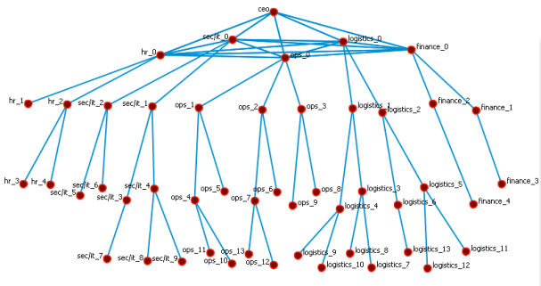
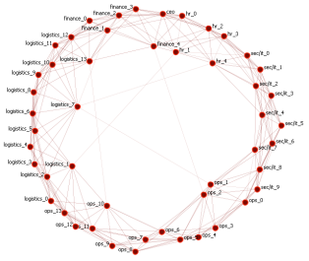
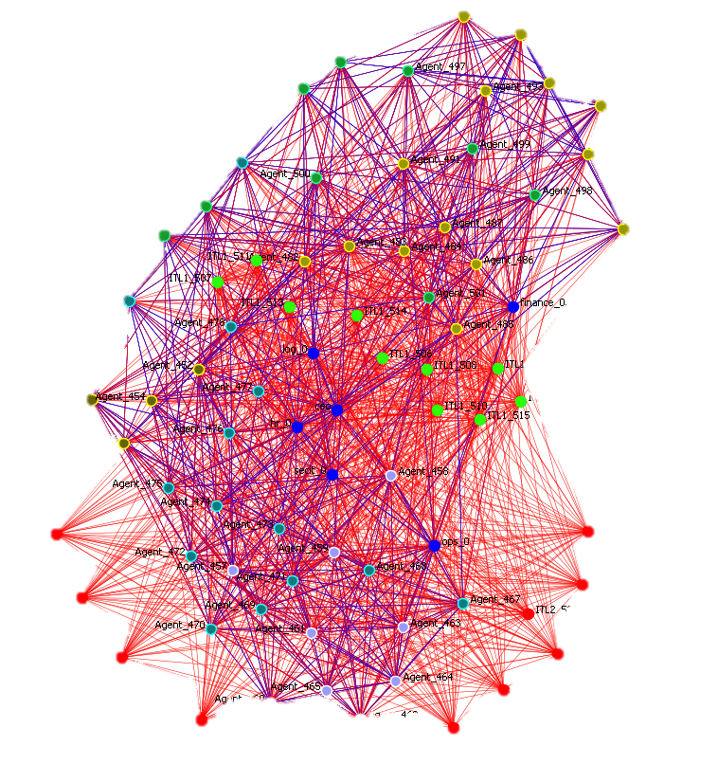
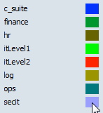
Hierarchy with C-Suite Roles
6 agent mesh for formal C-Suite links
Formal Network
Hierarchy by functional area
Fanout = Uniform Random(7±2)
Informal Network: Small World
P_{rewire} = 0.05 and P_{delete}= 0.05
Size_{local} =Uniform Random (7±2)
Agent x IT Level 1: Mesh
Cleared Agent x IT Level 2: Mesh
Visual Samples are to the left
Blue Link = Social Network Red Link = Agent x Agent

Slide 9
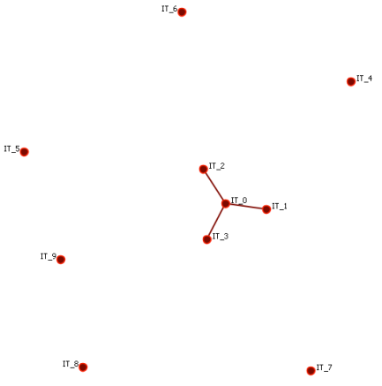
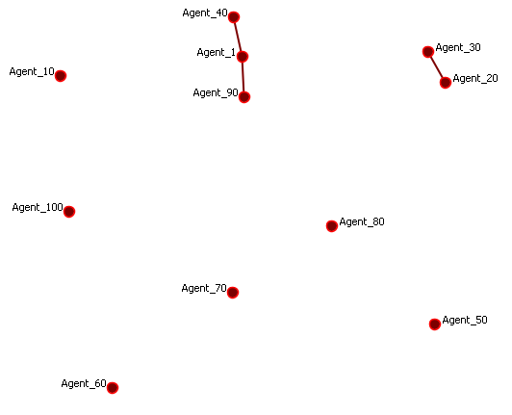
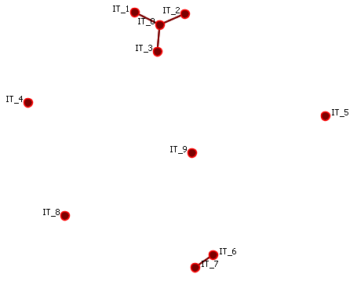
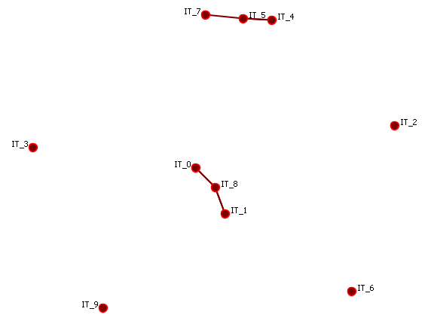
Modeling IT
Each staff member is mesh connected to each Level 1 IT system
Cleared staff members are mesh connected to each Level 2 IT system
IT Systems are push/pull (they can initiate as well as receive messages to other actors)
IT-to-IT Connections examined in two conditions,
Scale Free, Level 1 (Non-Secure) • Erdos-Renyi Random, Level 1
and Level 2 (Secure) (Non-Secure) and Level 2 (Secure)

Slide 10
Interactions between Actors
Human to Human
Intra-Location
Face to Face
Phone
Email
Inter-Location
Phone
Email
Human to Local IT
Direct
IT to IT
Direct
Human Egos
are boundedly rational
able to communicate knowledge facts & perceptions of other’s facts
can misperceive messages
can misperceive their alters’ knowledge
Give preference to plan-oriented knowledge
can update or get information from any IT system they have access to

Slide 11
Structuring Knowledge
Agents may have
Common organizational knowledge – “This is how we do things at Acme”
Locational-specific knowledge – “This is how we do things at Acme-Timbuktu”
Requirements knowledge
“Bad” Requirements knowledge – each bad knowledge fact negates the value of having one correct requirements knowledge fact
Knowledge has a classification level
Level 1 – Everyone can see it
Level 2 – Only cleared agents should see it
General -Lvl1 | Loc-Lvl1 | Plan-Lvl1 | Bad-Lvl1 | General-Lvl2 | Loc-Lvl2 | Plan-Lvl2 | Bad-Lvl2
99 | 80 | 3 | 2 | 1 | 20 | 27 | 13

Slide 12
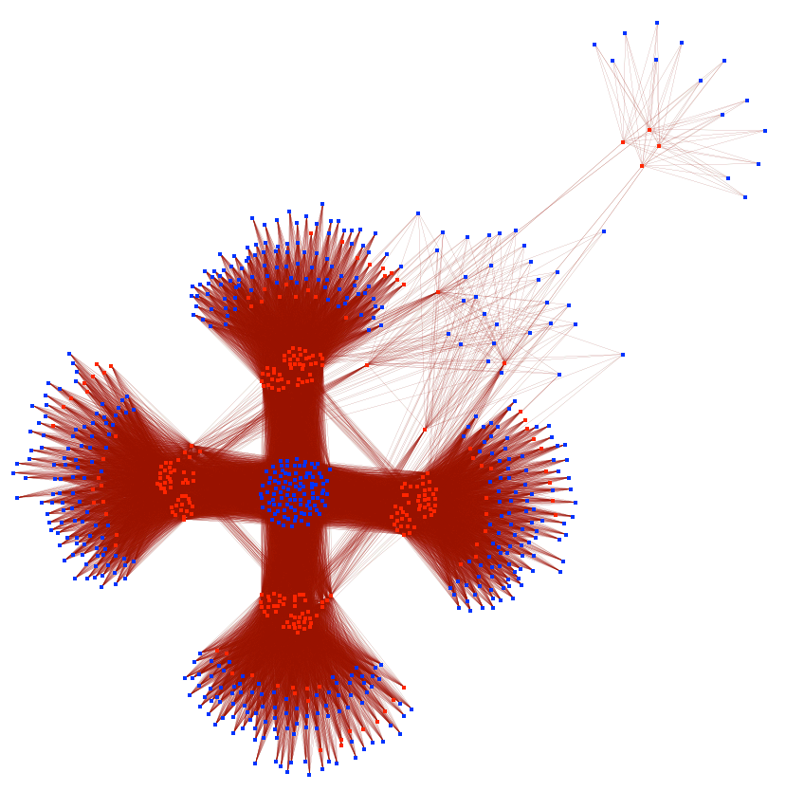
Modeling Multiple Locations
Agent x Agent
Organizations linked via
high density Erdos-Renyi of C-Suite agents
Key IT-systems per org
Special/Attack Agents linked to all key-IT systems
Inter-organizational Physical Proximity set
Agent x Agent (red)
Agent x Knowledge (blue)

Slide 13
Outputs
Measures will always be context dependent (e.g., a BCT will not be combat ready during block leave periods)
Our measures are:
Relative Time Measurements
Time to get 70% of requirements knowledge to 90% of all human actors
Time to get 80% of requirements knowledge to 90% of C-Suite actors
Time to return to baseline Performance as Accuracy
Time to return to baseline Knowledge & Task Congruence
Assessments of knowledge prevalence
Amount of bad knowledge across the organization, the C-Suite, and the IT Systems
Amount of Lvl 2 “Classified Knowledge” possessed by non-cleared human and IT actors

Slide 14
Experimental Summary
Condition | Possible Values | Combinations
Confidentiality Attack | 0/1 {if A=1, P_{effect}=0.3, 0.6, 0.9} | 2
Integrity Attack | 0/1 {if A=1, P_{effect}=0.3, 0.6, 0.9} | 1 + (1*3) = 4
Cyber Attack, Availability | A=0/1 {if A=1, P_{effect}=0.3, 0.6, 0.9} | 1 + (1*3) = 4
Locations Affected | 0,1,2,3,4 | 5
Org Configs | Erdos-Renyi Random, Hierarchy, Matrix, Mesh, Scale Free, Team | 6
IT-to-IT links (e.g., push/pull IT) distribution relative to Org Config | Scale Free, Erdos-Renyi | 2
 | Total Experimental Conditions | 1920
Number of Runs | 50
Total Runs |  | 1,920 * 50 = 96,000

Slide 15
Expectations
Contested Environments should slow down effective diffusion of the planning requirements
Effects of attack will be non-linear across locations and quantities of systems affected
Effects of attacks will also be non-linear across attack types
Confidentiality attacks may improve performance
Organizations with denser ties will tend to diffuse the information more rapidly, although there may be spillage of classified information.

Slide 16
Backup Slides

Slide 17
Modeling staff
Each staff member has a functional role
HR: 10% of Org : 10% has access to classified info
Sec/IT: 20% of Org : 90% has access to classified info
Ops: 30% of Org : 90% has access to classified info
Logistics: 30% of Org : 50% has access to classified info
Finance: 10% of Org : 10% has access to classified info
Staff members has both “works with” and “social” relationships, and “works with” relationships have priority for interaction
“Social” relationships are a stylized small-world network within the functional group
“Works With” ties are based on the experimental condition
Staff members do not have “shifts”, but that could be a later extension
Disabled: Beliefs, Beliefs Transactive Memory, Tasks, Task Learning, Knowledge Forgetting,

Slide 18
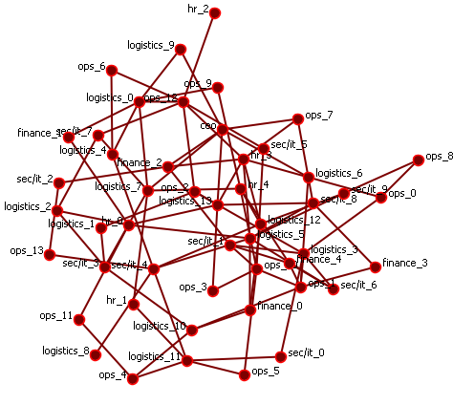
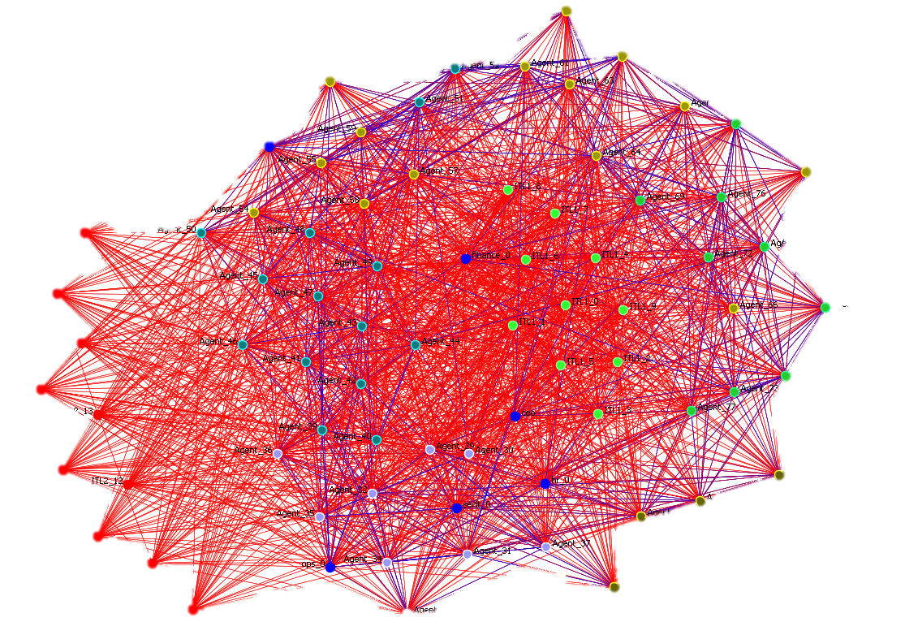
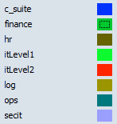
Erdos-Renyi Random with C-Suite Roles
6 agent mesh for formal C-Suite links
Formal Network
Erdos-Renyi Random P_{link}= 0.15
Informal Network: Small World
P_{rewire} = 0.05 and P_{delete}= 0.05
Size_{local} =Uniform Random (7±2)
Agent x IT Level 1: Mesh
Cleared Agent x IT Level 2: Mesh
Visual Samples to the left
Blue Link = Social Network Red Link = Agent x Agent

Slide 19
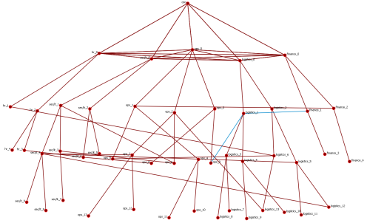
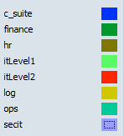
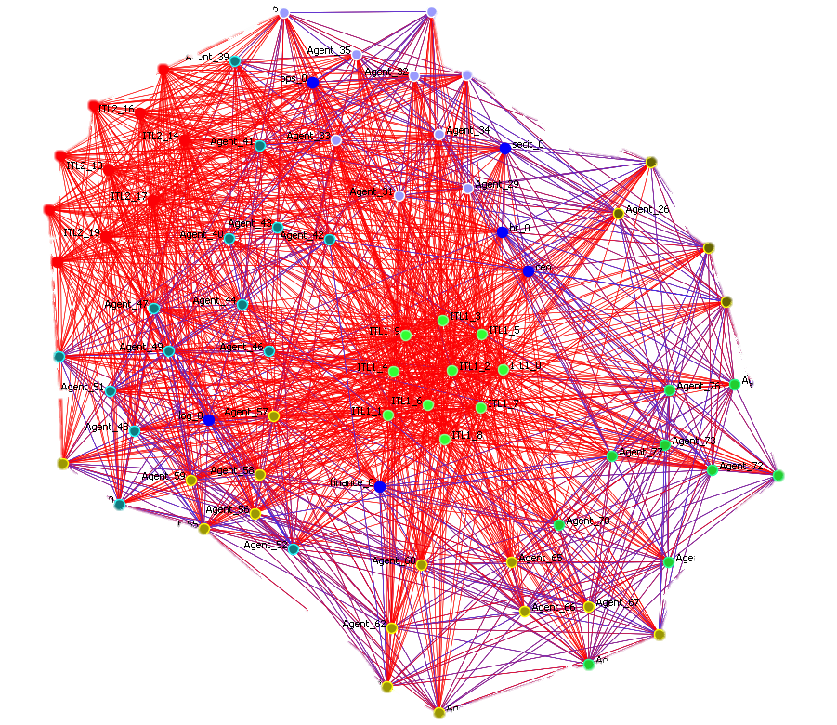
Matrix with C-Suite Roles
6 agent mesh for formal C-Suite links
Formal Network
Hierarchy by functional area
Fanout = Uniform Random(7±2)
Cross-Hierarchy Teams
3:1 Team:Functional Area
Curtailed Gaussian Random [1,∞), mean 8, std 2)
Functional Area Pop. per team <= 20%
Informal Network: Small World
P_{rewire} = 0.05 and P_{delete}= 0.05
Size_{local} =Random Uniform (7±2)
Agent x IT Level 1: Mesh
Cleared Agent x IT Level 2: Mesh
Visual Samples are to the left
Blue Link = Social Network Red Link = Agent x Agent

Slide 20
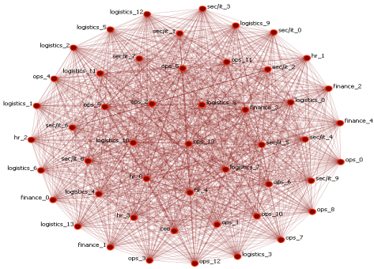
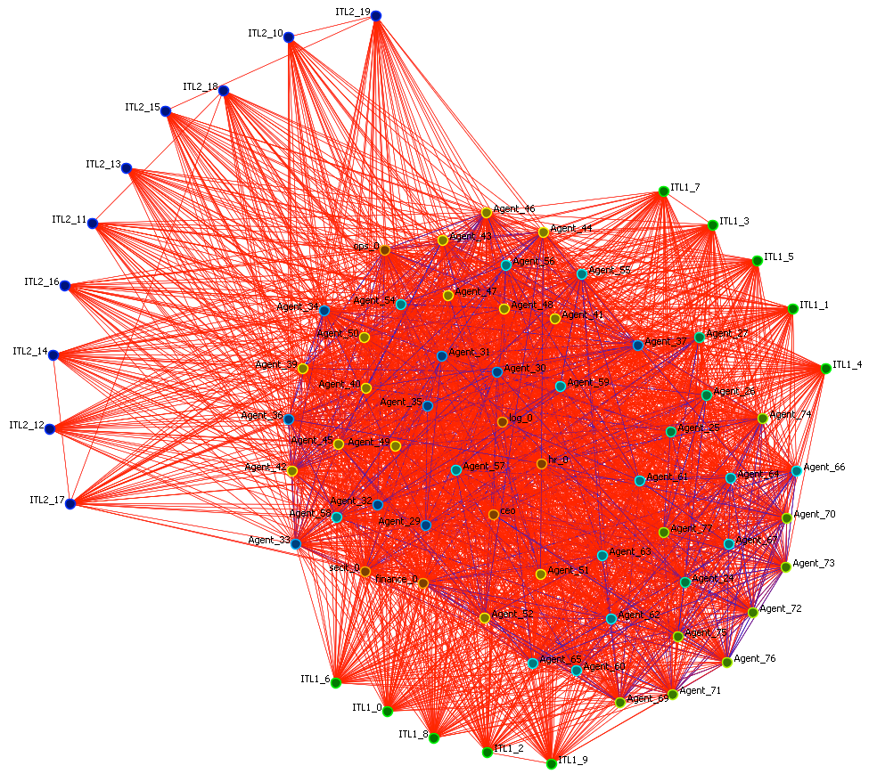
Complete Mesh with C-Suite Roles
6 agent mesh for formal C-Suite links
Formal Network
Complete Mesh
Informal Network: Small World
P_{rewire} = 0.05 and P_{delete}= 0.05
Size_{local} =Random Uniform (7±2)
Agent x IT Level 1: Mesh
Cleared Agent x IT Level 2: Mesh
Visual samples to the left
Blue Link = Social Network Red Link = Agent x Agent

Slide 21
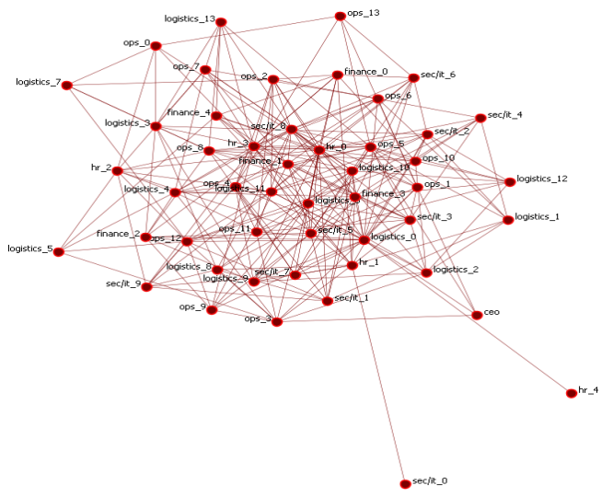
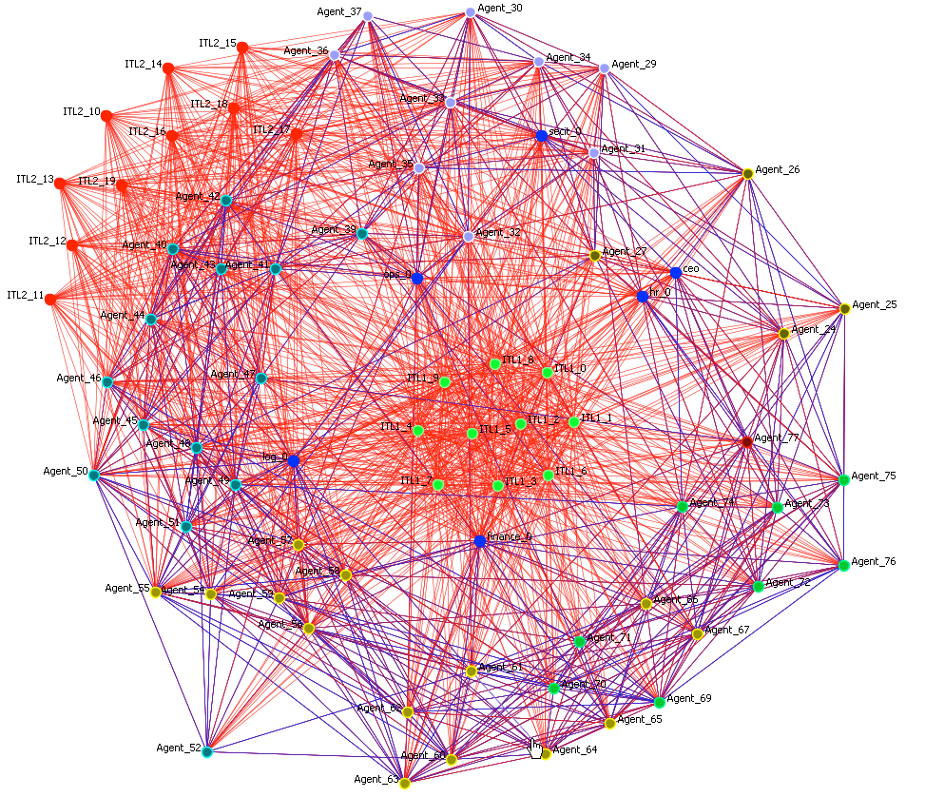
Scale Free with C-Suite Roles
6 agent mesh for formal C-Suite links
Formal Network
Scale Free via Preferential Attachment
Build Edges after C-Suite and Social Network in place
Density = 0.15
Informal Network: Small World
P_{rewire} = 0.05 and P_{delete}= 0.05
Size_{local} =Random Uniform (7±2)
Agent x IT Level 1: Mesh
Cleared Agent x IT Level 2: Mesh
Visual samples to the left
Blue Link = Social Network Red Link = Agent x Agent

Slide 22
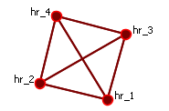
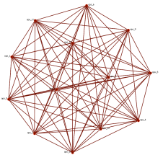
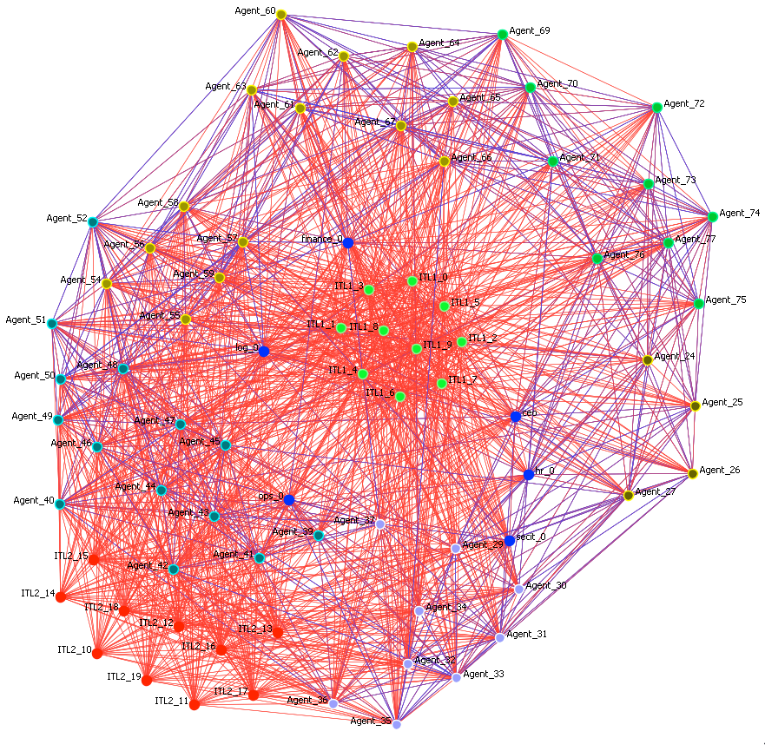
Functional Mesh/Team with C-Suite Roles
6 agent mesh for formal C-Suite links
Formal Network
Complete Mesh within each functional area
Informal Network: Small World
P_{rewire} = 0.05 and P_{delete}= 0.05
Size_{local} =Random Uniform (7±2)
Agent x IT Level 1: Mesh
Cleared Agent x IT Level 2: Mesh
Visual samples are to the left
Blue Link = Social Network Red Link = Agent x Agent

Slide 23
Scenarios of Interest
For all
A generic multi-location organization is engaged in planning an integrated COA
Each location has received a set of planning documents and tasked a Planning team (PT) to analyze the classified documents, distribute their analysis to the key leaders of the organization to gain their input, and develop a plan to meet the intent of the planning documents
This experiment will explore
Uncontested vs. 3 types of Contested Cyber Environments
Hierarchical vs. Teams vs. Matrix Organizations vs. Random vs. Scale Free
And will examines these outputs
Change in Time for plan knowledge to reach key decision makers
Change in Time to get general planning knowledge to all actors
Amount of bad knowledge present in the organization, in the minds of key decision makers, and in IT systems
Amount of “spillage” of classified Knowledge to actors and IT systems not cleared for that knowledge
Notes:
We should extend operations to be modeled using an activity network – with stylized but predefined steps

Slide 24
Planning an integrated COA
A multi-location organization is attempting to develop an integrated (across all locations) Course of Action (COA)
The requirements of that Course of Action are represented as stylized knowledge facts – some of these facts are classified, and some are not.
CMU FOCUS
Location 1
Location 2
Location 3
Location 4

Slide 25
Communication Structure
Planning team members prefer to communicate with those physically near them (other planning team members)
Heads of divisions communicate with each other and members of their division
Communication network within division is set per experimental condition
Head of functional area communicates to the two most central people in their area
Functional heads, division heads and division sub-heads are in a small world network – 11 connections
Communication network within a functional area is random
Inter-AOC communication
through C-Suite & Planning Teams (e.g., HR communicates with HR)
through “Core” IT systems

Slide 26
Modeling Communications Media
Face-to-face:
maxMsgComplexity: 4 - max%Learnable: 100
Time_to_live: 1 - Time_to_send: 1
Phone:
maxMsgComplexity: 3 - max%Learnable: 50
Time_to_live: 1 - Time_to_send: 1
Email:
maxMsgComplexity: 6 - max%Learnable: 70
Time_to_live: 3 - Time_to_send: 1

Slide 27
People to People Network Structure for ‘Regional AOC’
Sized by Authority Centrality and Colored by Betweeness Centrality (Blue is most central)
Functional Groups’ Agents collapsed into ‘meta-nodes’

Slide 28
High Level Assumptions
Model Assumptions:
Humans must receive information to gain it
Humans tend to interact with people similar to themselves
Regular human interactions within organizations are typically constrained by role and function
Information is divisible into smaller portions, and those portions can be communicated by human actors in such a way as to be re-constructible by the receiving agent
Cyber Attacks:
Can modify or destroy information
Delay or inhibit communication

Slide 29
Ability to Operate
People need 25% of the knowledge of the OPORD to begin to plan
People need 60% to complete an effective plan
Under normal conditions they get this information eventually
There is a time to get minimum knowledge
There is at each time a number of people and so a number of divisions that have that minimum knowledge

Slide 30
How are Planning Requirements Communicated
In bits and pieces
Requirements go to the planning team at each location, all core IT systems initially (level 1 & level 2), and small portion CEO
Planning team goes through a plan-brief cycle
Briefings: 3
Total Planning time: 1/3:2/3 rule of total time
Total Briefing time: 1/5 of Planning Time
During Briefings
‘Plan’ knowledge given probabilistic preference over ‘general’ or ‘location’ knowledge
‘Attendees’ adjust preferences of interaction to planning team members
Human actors can pass 2 to 5 bits per time
IT systems can pass 5 to 15 bits per time
IT systems are ‘push’ (can initiate communications)

Slide 31
Where Can Cyber Attacks Manifest
Within Location
Between Locations
AOC
A
AOC
B

Slide 32
Point of Contact
Prof. Kathleen M. Carley
Wean 5130
Carnegie Mellon University
5000 Forbes Ave.
Pittsburgh, PA 15213 USA
Tel: 412-268-6016
Fax: 412-268-1744
kathleen.carley@CS.CMU.EDU

